Slide 1
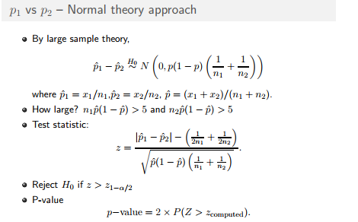

Slide 2
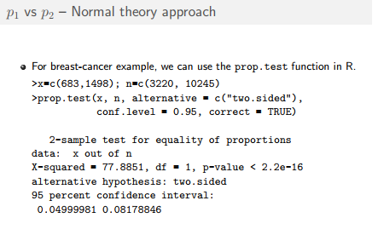

Slide 3
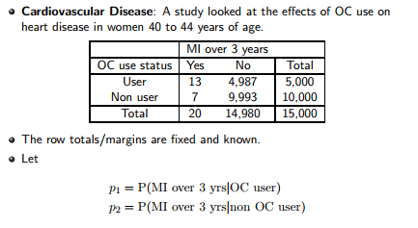

Slide 4
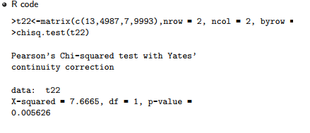

Slide 5
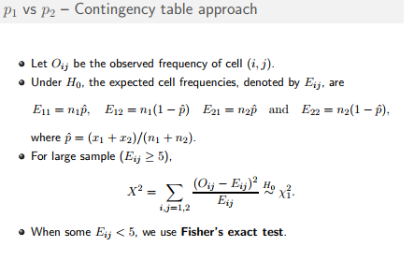

Slide 6
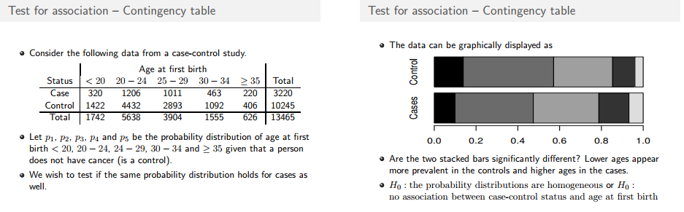

Slide 7
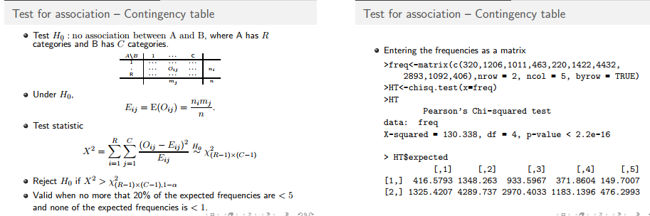

Slide 8
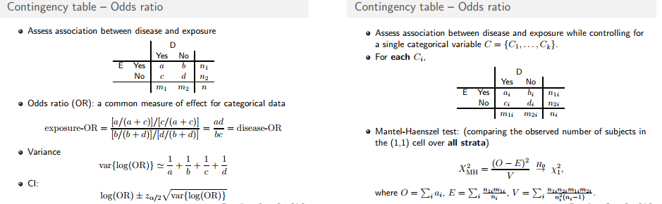

Slide 9
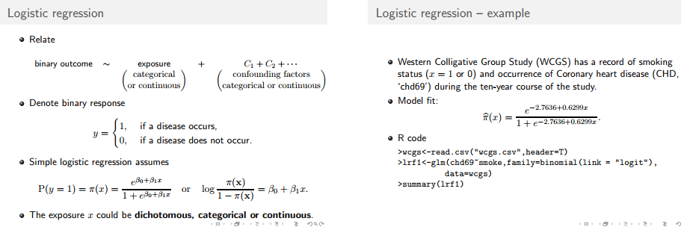

Slide 10
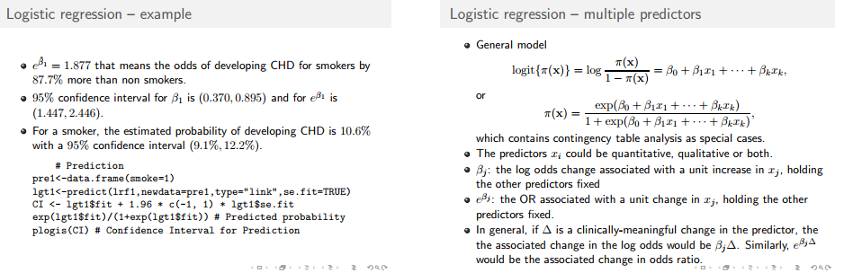

Slide 11
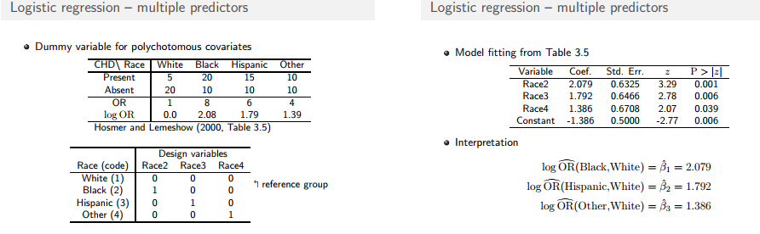

Slide 12
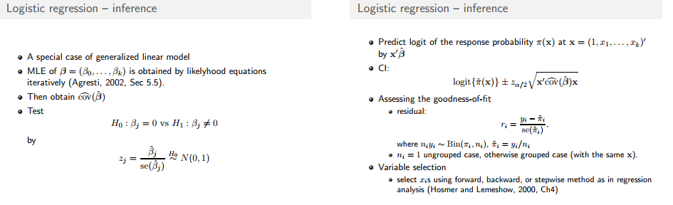

Slide 13
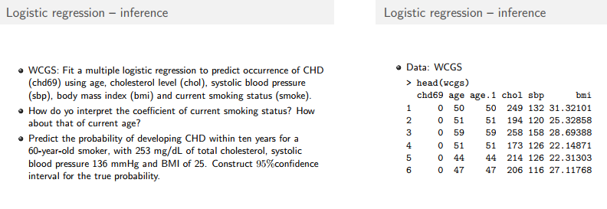

Slide 14
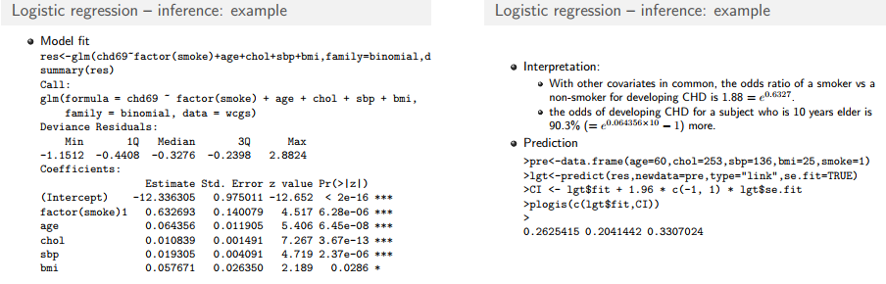

Slide 15
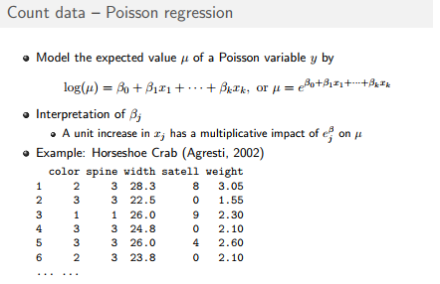

Slide 16
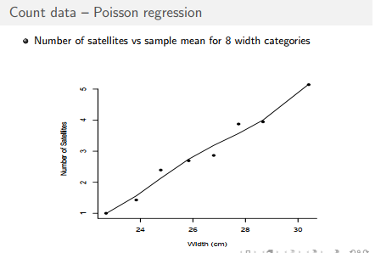

Slide 17
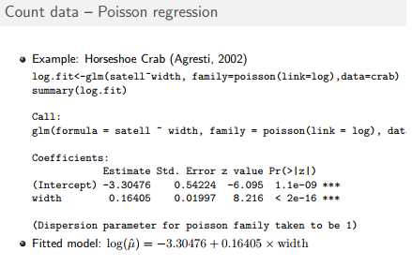

Slide 18
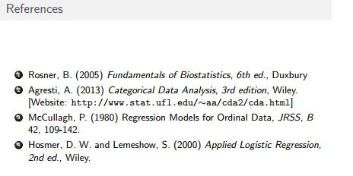

Slide 19
Properties of a random sample
A random sample is a set of observations or measurements drawn from a population according to a specific sampling method.
Each observation in the sample is a random variable, and the collection of these random variables forms a random sample.
The distribution of a random sample depends on several factors, including the underlying distribution of the population, the size of the sample, and the sampling method used.
Here are some common scenarios regarding random samples and their distributions:
Sample from a Known Distribution: If the population distribution is known, and the sample is drawn randomly from this distribution, then the distribution of the sample will match the population distribution.
- For example, if the population follows a normal distribution, then a random sample drawn from this population will also follow a normal distribution.

Slide 20
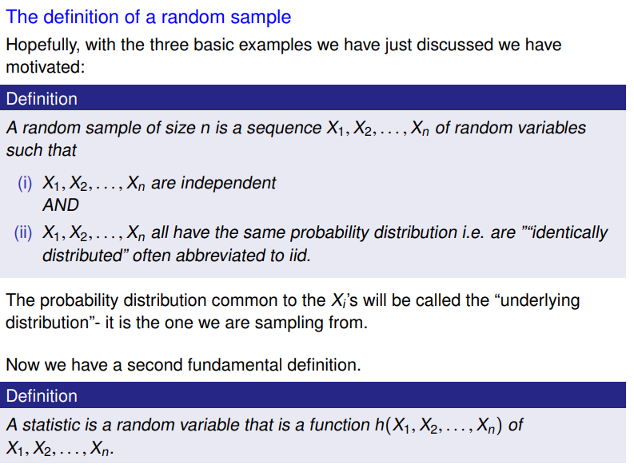

Slide 21
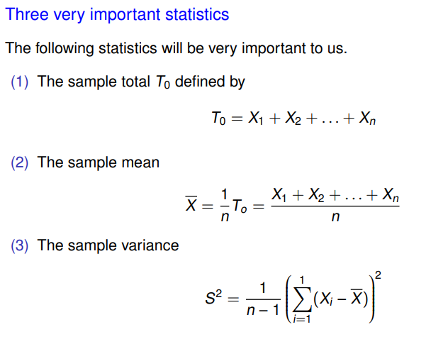
Cont…

Slide 22
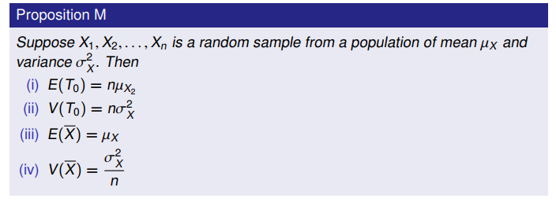
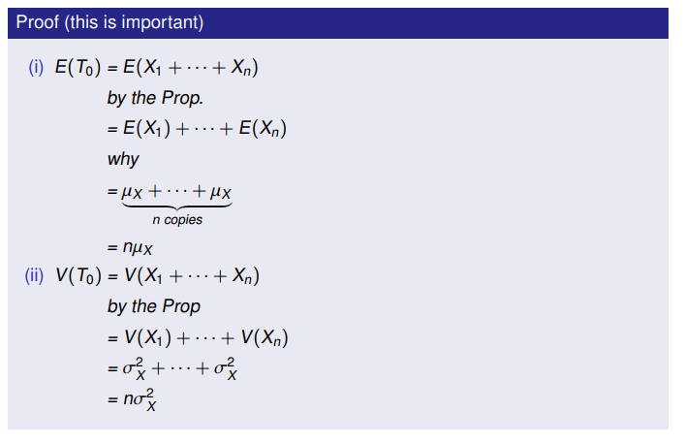
Cont…

Slide 23
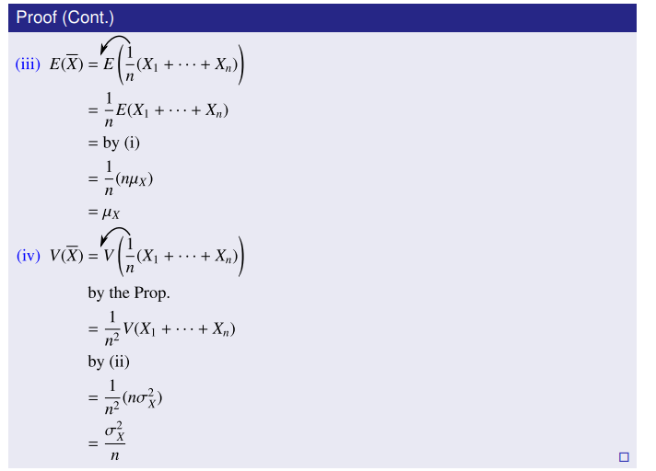

Slide 24
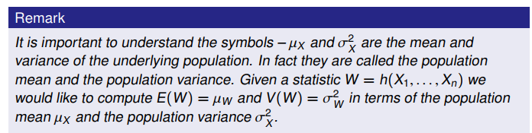
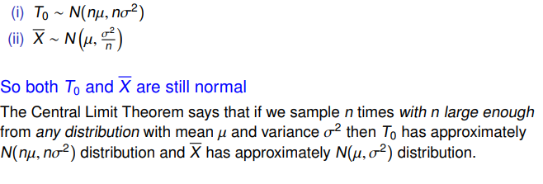
Cont…
if we sampled n times from a normal distribution with mean µ and variance σ2 then

Slide 25
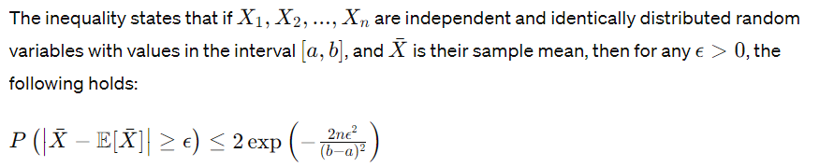
Hoeffding's Inequality
Hoeffding's inequality provides an upper bound on the probability that the sample mean of independent and identically distributed (i.i.d.) random variables deviates from its expected value by more than a certain amount.
It is particularly useful in the context of concentration inequalities and is widely used in machine learning and statistics.

Slide 26
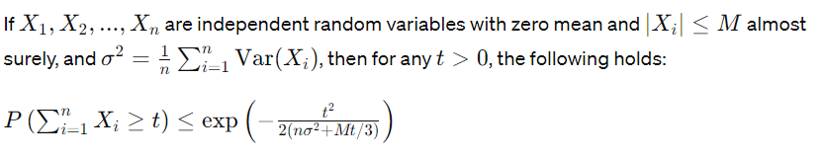
Bernstein's Inequality
Bernstein's inequality is another concentration inequality that provides a bound on the tail probability of the sum of independent random variables.
It relaxes the condition of Hoeffding's inequality by allowing for random variables with different variances.

Slide 27
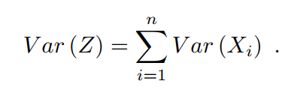
The Efron-Stein inequality
One of the main messages of this book is that, in a certain sense, sums of independent random variables have an extremal place in the world of general functions of independent random variables.
Before deriving a bound for the variance of a general function Z of independent random variables (this problem, of course, only makes sense when Z is square integrable), we can gain some insight by considering first the very special case when the variables X1,…, Xn are real-valued and Z = X1 + · ·· + Xn. In this case we can use the exact formula

Slide 28
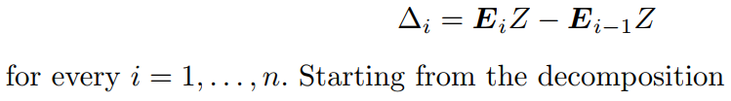
Cont…
Of course, the proof of this formula uses independence only through the pairwise orthogonally of the variables Xi – E(Xi).
Now it is a natural idea to bound the variance of a general function by expressing Z – E(Z) as a sum of martingale differences for the Doob filtration and use the orthogonally of these differences.
More precisely, if we denote by Ei the conditional expectation operator, conditioned on (X1,…,Xi), and use the convention E0 = E, then we may define

Slide 29
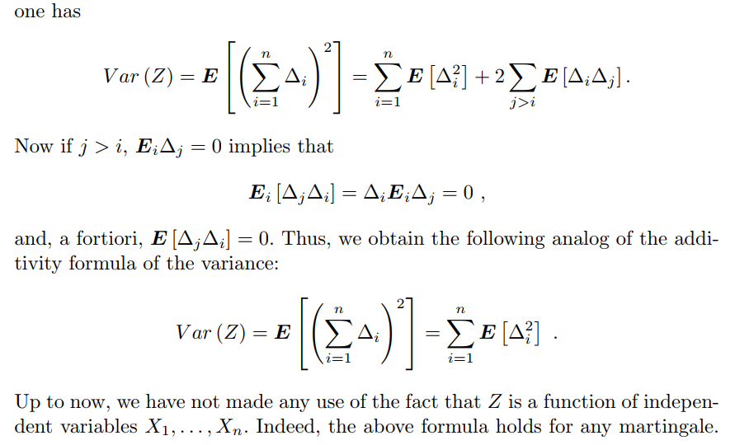

Slide 30
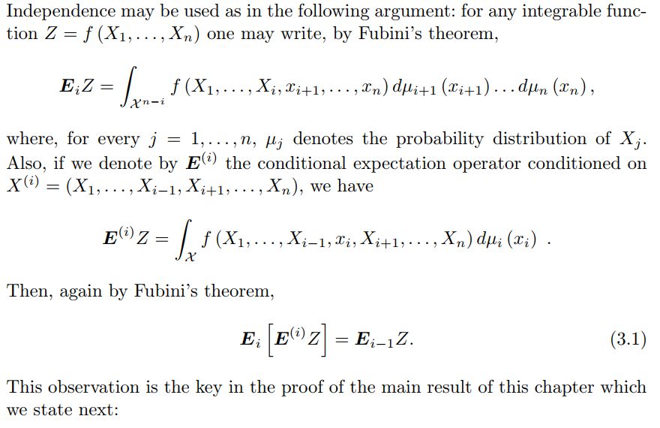

Slide 31
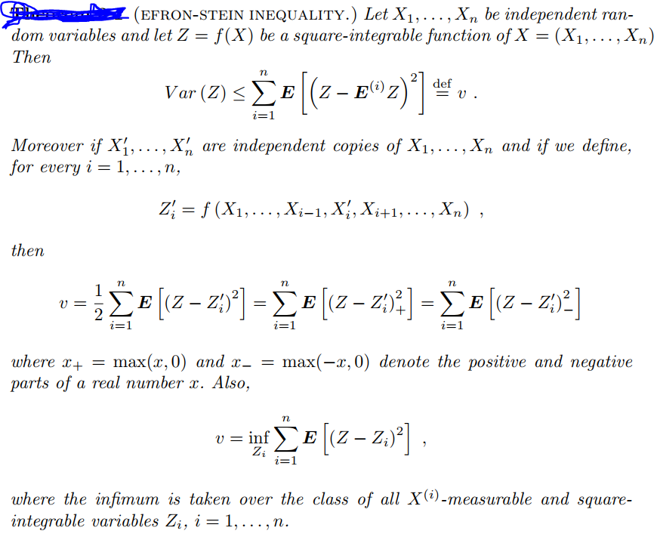

Slide 32

Exponential families of distributions
Exponential families of distributions are a fundamental concept in probability theory and statistics.
They are a class of probability distributions that have certain mathematical properties, making them particularly useful in statistical inference and modeling.
A probability distribution f(x;θ) is said to belong to an exponential family if it can be expressed in the form:
Where:
x is the random variable.
θ=(θ1​,θ2​,...,θk​) is a vector of parameters.
h(x) is a known function.
Ti​(x) are known functions called sufficient statistics.
A(θ) is the log-partition function, also known as the cumulant function, which ensures that the distribution integrates to 1 over its support.

Slide 33
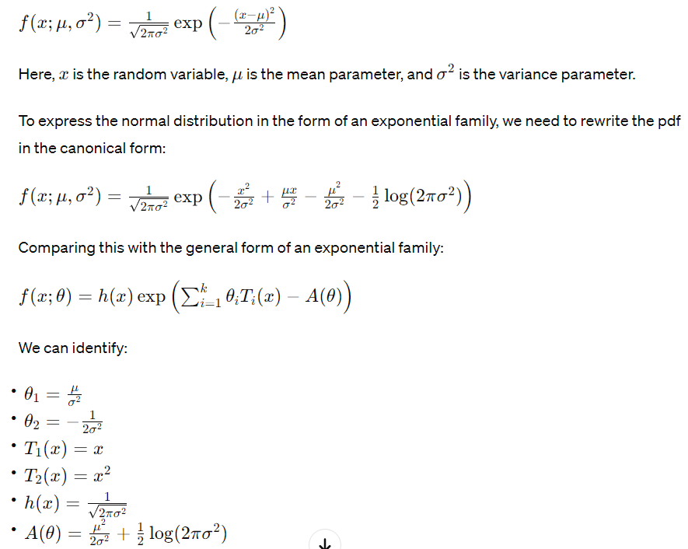
example
The normal distribution, also known as the Gaussian distribution, can be represented within the framework of exponential families.
The probability density function (pdf) of the normal distribution is given by:

